Slide 1
Interaction Diagrams

Slide 2
Interaction Diagram
Can model the way a group of objects collaborate to realize some behaviour.
How many interaction diagrams to draw for a development project?
  Typically each interaction diagram realizes behaviour of a single use case
  Draw one sequence diagram for each use case.

Slide 3
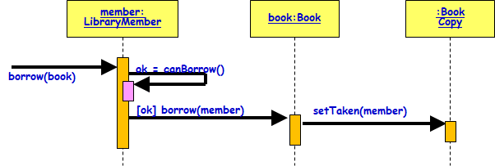
Interaction Diagrams
Three kinds:
  Interaction overview diagram
  Sequence and Collaboration (now communication diagram in UML 2.0) diagrams.
Sequence and Collaboration diagrams are actually equivalent:
  Portray different perspectives
As we shall see:
  These diagrams play a very important role in any design process.

Slide 4
Interaction Overview Diagram
Focuses on the overview of the flow of control of the interactions.
It is a variant of the Activity Diagram:
  Nodes are sequence diagrams.
  Describes the interactions where messages and lifelines are hidden…

Slide 5
Interaction Overview Diagram
Each individual activity is pictured as a frame:
  which can contain a nested interaction diagrams.
This makes the interaction overview diagram useful to deconstruct a complex scenario:
  That would otherwise require multiple if-then-else paths to be illustrated as a single sequence diagram"

Slide 6
Interaction Overview Diagram
sd Withdrawal
Skip
ref
Authenticate
PIN OK
PIN NOK
sd
sd
:User
:ATM
:Bank
:User
:ATM
withdraw
msg (“illegal entry”)
msg (“amount”)
amount (a)
chkAcct (a)
sd
sd
:User
:ATM
:Bank
:User
:ATM
:Bank
enough bal
not enough bal
money
msg(“amount too big”)
receipt
sd
:User
:ATM
msg (“card”)

Slide 7
A First Look at Sequence Diagrams
Captures how objects interact with each other:
  To realize some behavior.
Emphasizes time ordering of messages.
Can model:
  Simple sequential flow, branching, iteration, recursion, and concurrency.
member:
LibraryMember
book:Book
:Book
Copy
borrow(book)
ok = canBorrow()
[ok] borrow(member)
setTaken(member)

Slide 8
Simple Rule: Develop One Sequence diagram for every use case
Use Case
Return Book
member:
LibraryMember
book:Book
:Book
Copy
ok = canBorrow()
borrow(book)
Borrow Book
Borrow Book
[ok] borrow(member)
Search Book
setTaken(member)

Slide 9
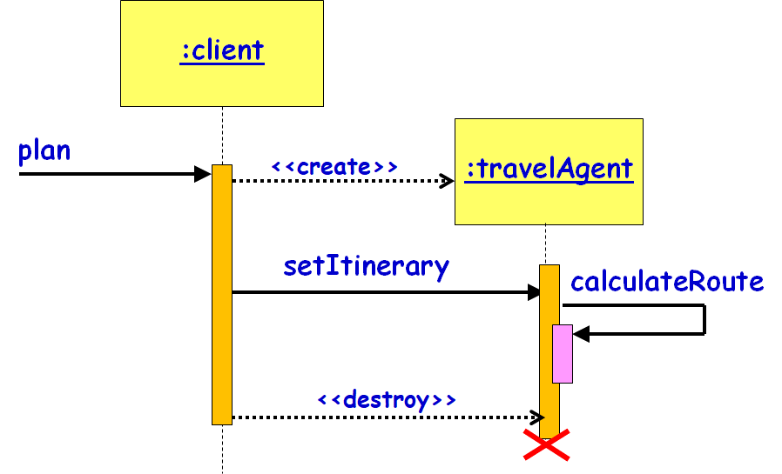
Sequence Diagram
Shows interaction among objects as a two-dimensional chart
Objects are shown as boxes at top
If object created during execution:
  Then shown at appropriate place in time line
Object existence is shown as dashed lines ‏
Object activeness, shown as a rectangle on lifeline

Slide 10
Elements of A Sequence Diagram
Messages are shown as arrows.
Each message labelled with corresponding message name.
Each message can be labelled with some control information.
Two types of control information:
  condition ([])‏
  iteration (*)‏
member:
LibraryMember
book:Book
:Book
Copy
borrow(book)
ok = canBorrow()
[ok] borrow(member)
setTaken(member)

Slide 11
Gist of Syntax
iteration marker *[for all objects]
[condition]
  Message is sent only if the condition is true
self-delegation
  a message that an object sends to itself
Loops and conditionals:
  UML2 uses a new notation called interaction frames to support these
member:
LibraryMember
book:Book
:Book
Copy
borrow(book)
ok = canBorrow()
[ok] borrow(member)
setTaken(member)

Slide 12
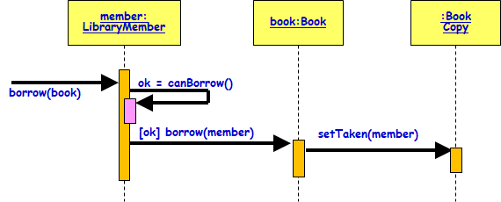
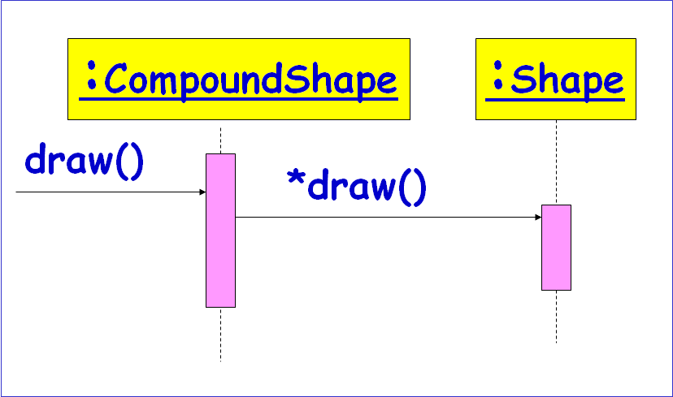
Control logic in Interaction Diagrams
Conditional Message
  [ variable = value ] message()
  Message is sent only if clause evaluates to true
Iteration (Looping)
  * [ i := 1..N ] message()
  “*” is required; [ ... ] clause is optional
  The message is sent many times to possibly multiple receiver objects.

Slide 13
Elements of A Sequence Diagram
X-Axis (objects)
member:
LibraryMember
book:Book
:Book
Copy
borrow(book)
Object
Life Line
ok = canBorrow()
Y-Axis (time)
message
Activation box
[ok] borrow(member)
setTaken(member)
condition
How do you show Mutually exclusive conditional message?

Slide 14
Sequence Diagrams
How to represent Mutually exclusive conditional messages? Eg. msg2 to ClassB or msg3 to classC,
:ClassA
:ClassB
:ClassC
msg1( )
[flag = true] msg2( )
[flag = false] msg3( )

Slide 15
Representing an object
Class name, optionally preceded by object name and colon:
  write object's name if it clarifies the diagram
  object's "life line" represented by dashed vertical line
Object
Anonymous
Active object
Object of unknown Class
Smith : Patient
:Patient
Smith
Active object
Object
LifeLine
Name syntax: <object name>:<class name>

Slide 16
Messages between objects
Message (method call) indicated by a horizontal arrow to other object:
  Dashed arrow back indicates return
  different arrowheads Sync/Async calls
Message name
Guard condition
arguments
[registered] Admit (pateintID, room type)
: Hospital
:Controller
Procedure Call
:Controller
:Controller
asynchronous
Synchronous flow of control
return

